Slide 1
TED Talks
Nidhishree Sanam & SravaniRavulaparthi

Slide 2
Introduction
This data set is about the TED Talks.
As TED is one of the best learning platforms to learn from the experiences of the best people from different fields.
Ted Talks are organized by a specific author, and this would be rated based on the number of views and likes for that program.
In This project we can answer the following questions
Finding the most popular TED talks
Finding the most popular TED talks Speaker (in terms of number of talks)
Month-wise Analysis of TED talk frequency
Year-wise Analysis of TED talk frequency

Slide 3
Tables

Slide 4

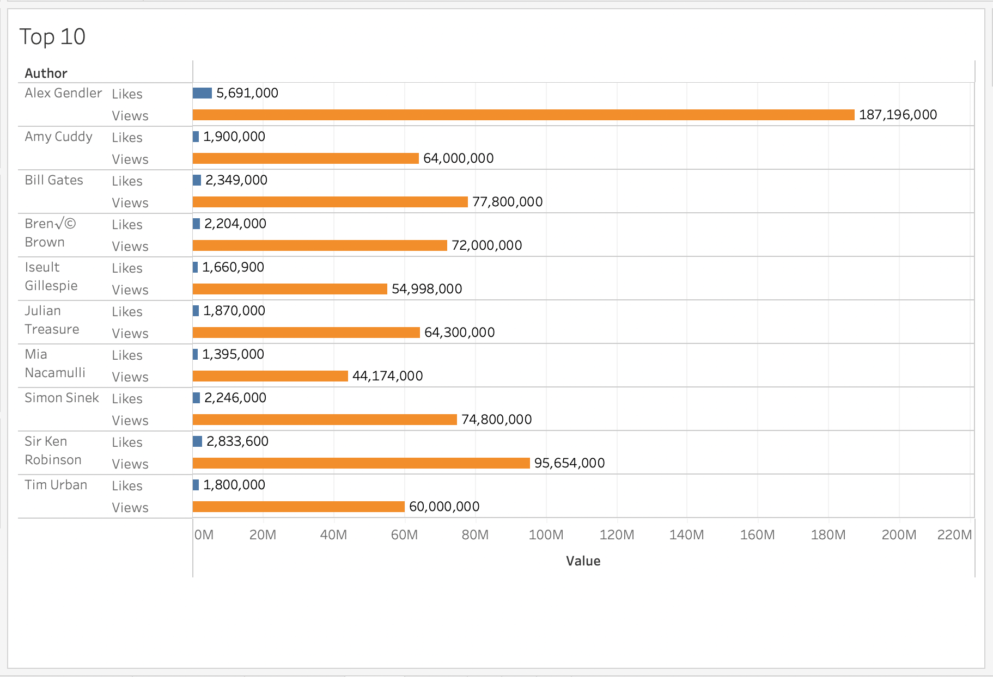
analysis
These are the top 10 authors in terms of views & likes.

Slide 5
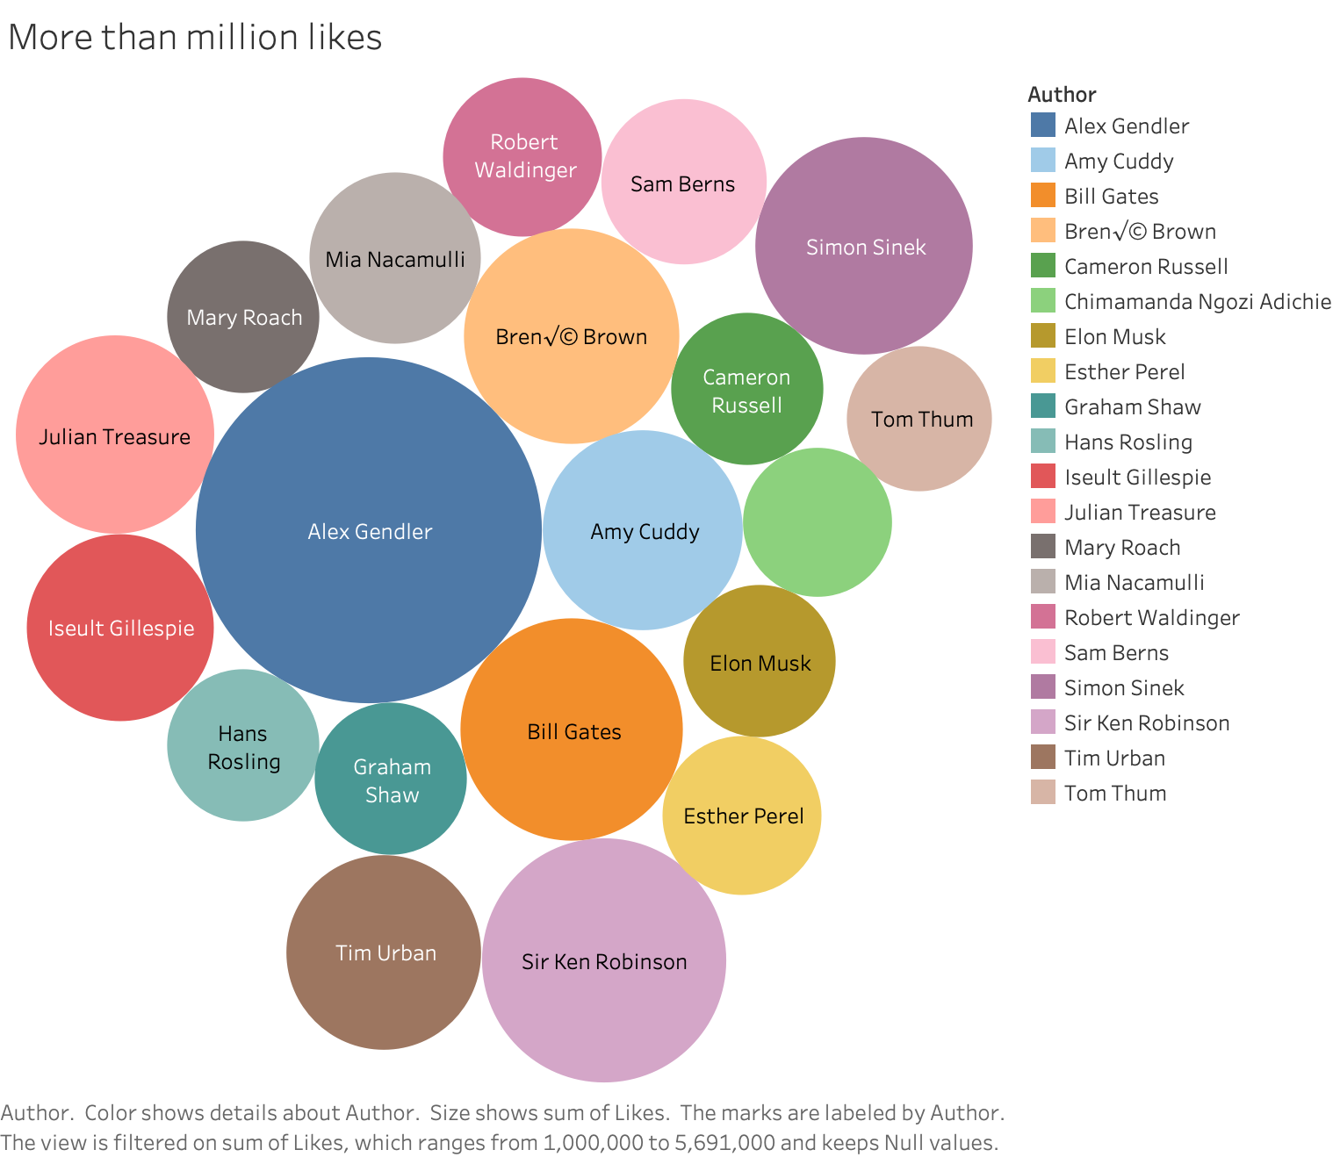
Authors with more than a million likes

Slide 6
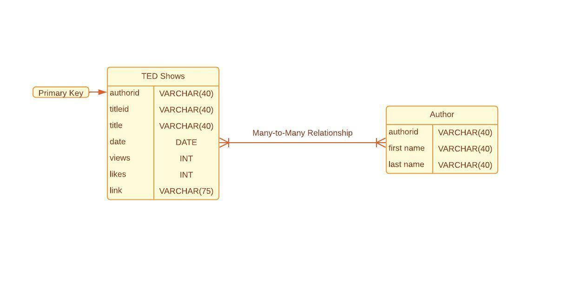
ER-Diagram of the data

Slide 7
Summary
Alex gendler has the greatest number of views & likes than any other author in the period from Feb. 1984 to Feb. 2022.
The most number of views is recorded in the month of April 2017.
It is safe to assume from our analysis that the number of people watching ted talks has decreased gradually since April 2019.

